Slide 2
Overview
Part 1 – Design Procedure
  Steps
    Specification
    Formulation
    Optimization
    Technology Mapping
  Beginning Hierarchical Design
  Technology Mapping - AND, OR, and NOT to NAND or NOR
  Verification
    Manual
    Simulation

Slide 3
Overview (continued)
Part 2 – Combinational Logic
  Functions and functional blocks
  Rudimentary logic functions
  Decoding using Decoders
    Implementing Combinational Functions with Decoders
  Encoding using Encoders
  Selecting using Multiplexers
    Implementing Combinational Functions with Multiplexers

Slide 4
Combinational Circuits
A combinational logic circuit has:
  A set of m Boolean inputs,
  A set of n Boolean outputs, and
  n switching functions, each mapping the 2^{m} input combinations to an output such that the current output depends only on the current input values
A block diagram:
Combinatorial
Logic
Circuit
m Boolean Inputs
n Boolean Outputs

Slide 5
Design Procedure
Specification
  Write a specification for the circuit if one is not already available
Formulation
  Derive a truth table or initial Boolean equations that define the required relationships between the inputs and outputs, if not in the specification
  Apply hierarchical design if appropriate
Optimization
  Apply 2-level and multiple-level optimization
  Draw a logic diagram or provide a netlist for the resulting circuit using ANDs, ORs, and inverters

Slide 6
Design Procedure
Technology Mapping
  Map the logic diagram or netlist to the implementation technology selected
Verification
  Verify the correctness of the final design manually or using simulation

Slide 7
Design Example
Specification
  BCD to Excess-3 code converter
  Transforms BCD code for the decimal digits to Excess-3 code for the decimal digits
  BCD code words for digits 0 through 9: 4-bit patterns 0000 to 1001, respectively
  Excess-3 code words for digits 0 through 9: 4-bit patterns consisting of 3 (binary 0011) added to each BCD code word
  Implementation:
    multiple-level circuit
    NAND gates (including inverters)

Slide 8
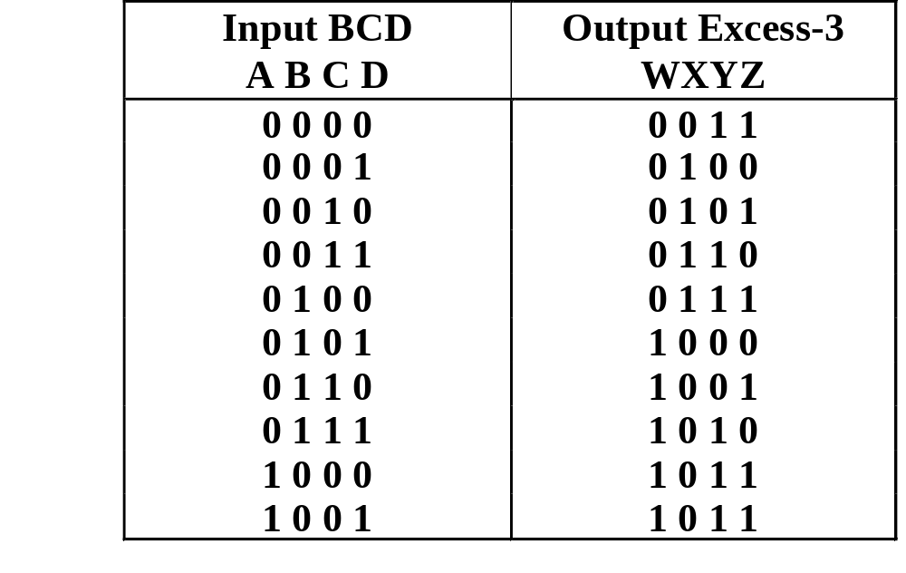
Design Example (continued)
Formulation
  Conversion of 4-bit codes can be most easily formulated by a truth table
  Variables
  - BCD:
  A,B,C,D
  Variables
  - Excess-3
  W,X,Y,Z
  Don’t Cares
  - BCD 1010
  to 1111

Slide 9
Design Example (continued)
C
C
Optimization
  2-level using
  K-maps
W = A + BC + BD
X = C + D + B
Y = CD +
Z =
z
y
1
1
1
1
0
1
3
2
0
1
3
2
1
1
1
1
4
5
7
6
B
4
5
7
6
B
X
X
X
X
X
X
X
X
A
12
13
15
14
A
12
13
15
14
1
X
X
1
X
X
B
B
C
D
8
9
11
10
8
9
11
10
D
D
C
D
D
x
C
C
w
1
1
1
0
1
3
2
0
1
3
2
1
1
1
1
4
5
7
6
B
4
5
7
6
B
X
X
X
X
X
X
X
X
A
12
13
15
14
A
12
13
15
14
1
X
X
1
1
X
X
8
9
11
10
8
9
11
10
D
D

Slide 10
Design Example (continued)
Optimization (continued)
  Multiple-level using transformations
  W = A + BC + BD
  X = C + D + B
  Y = CD +
  Z = G = 7 + 10 + 6 + 0 = 23
  Perform extraction, finding factor:
  T₁ = C + D
  W = A + BT₁
  X = T₁ + B
  Y = CD +
  Z = G = 2 + 4 + 7 + 6 + 0 = 19
B
B
C
D
C
D
D
B
C
D
C
D
D

Slide 11
Design Example (continued)
Optimization (continued)
  Multiple-level using transformations
  T₁ = C + D
  W = A + BT₁
  X = T₁ + B
  Y = CD +
  Z = G = 19
  An additional extraction not shown in the text since it uses a Boolean transformation: ( = C + D = ):
  W = A + BT₁
  X = T₁ + B
  Y = CD +
  Z = G = 2 + 4 + 6 + 4 + 0 = 16!
B
C
D
C
D
D
C
D
T₁
B
T₁
T₁
D

Slide 12
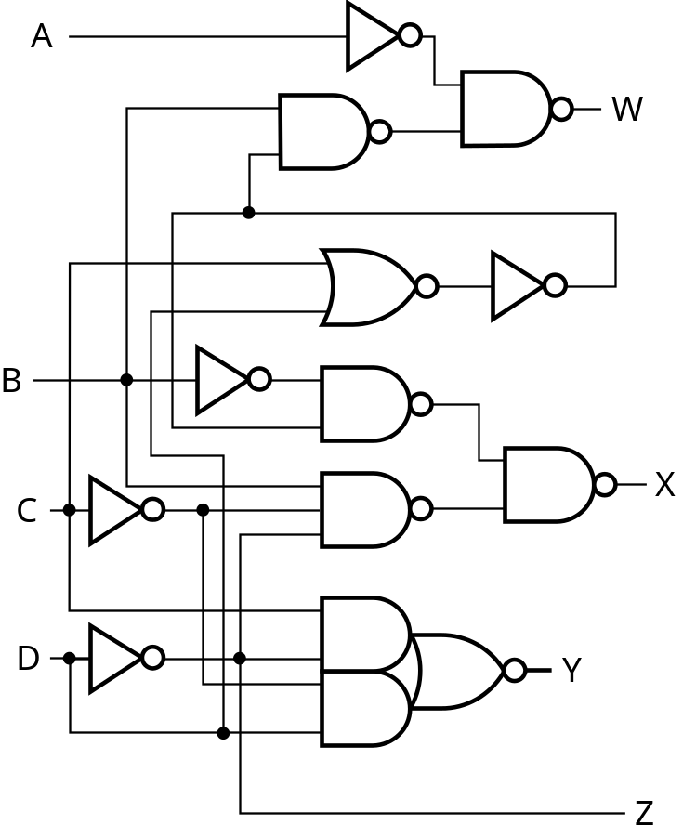
Design Example (continued)
Technology Mapping
  Mapping with a library containing inverters and 2-input NAND, 2-input NOR, and 2-2 AOI gates
A
W
B
X
C
Y
D
Z

Slide 13
Beginning Hierarchical Design
To control the complexity of the function mapping inputs to outputs:
  Decompose the function into smaller pieces called blocks
  Decompose each block’s function into smaller blocks, repeating as necessary until all blocks are small enough
  Any block not decomposed is called a primitive block
  The collection of all blocks including the decomposed ones is a hierarchy
Example: 9-input parity tree (see next slide)
  Top Level: 9 inputs, one output
  2nd Level: Four 3-bit odd parity trees in two levels
  3rd Level: Two 2-bit exclusive-OR functions
  Primitives: Four 2-input NAND gates
  Design requires 4 X 2 X 4 = 32 2-input NAND gates

Slide 14
Hierarchy for Parity Tree Example
X
0
X
1
X
2
9-Input
X
3
odd
X
4
Z
O
X
5
function
X
X
6
0
A
0
3-Input
X
7
A
odd
X
8
X
1
1
function
B
O
(a) Symbol for circuit
X
2
A
2
X
3
A
0
3-Input
A
0
3-Input
X
4
A
1
odd
B
O
A
1
odd
B
O
Z
O
X
A
function
A
function
5
2
2
X
6
A
0
3-Input
X
7
A
1
odd
B
O
X
A
function
8
2
(b) Circuit as interconnected 3-input odd
function blocks
A
0
A
1
B
O
A
2
(c) 3-input odd function circuit as
interconnected exclusive-OR
blocks
(d) Exclusive-OR block as interconnected
NANDs

Slide 15
Reusable Functions
Whenever possible, we try to decompose a complex design into common, reusable function blocks
These blocks are
  verified and well-documented
  placed in libraries for future use

Slide 16
Top-Down versus Bottom-Up
A top-down design proceeds from an abstract, high-level specification to a more and more detailed design by decomposition and successive refinement
A bottom-up design starts with detailed primitive blocks and combines them into larger and more complex functional blocks
Design usually proceeds top-down to known building blocks ranging from complete CPUs to primitive logic gates or electronic components.
Much of the material in this chapter is devoted to learning about combinational blocks used in top-down design.

Slide 17
Technology Mapping
Mapping Procedures
  To NAND gates
  To NOR gates

Slide 18
Mapping to NAND gates
Assumptions:
  Gate loading and delay are ignored
  Cell library contains an inverter and n-input NAND gates, n = 2, 3, …
  An AND, OR, inverter schematic for the circuit is available
The mapping is accomplished by:
  Replacing AND and OR symbols,
  Pushing inverters through circuit fan-out points, and
  Canceling inverter pairs

Slide 19
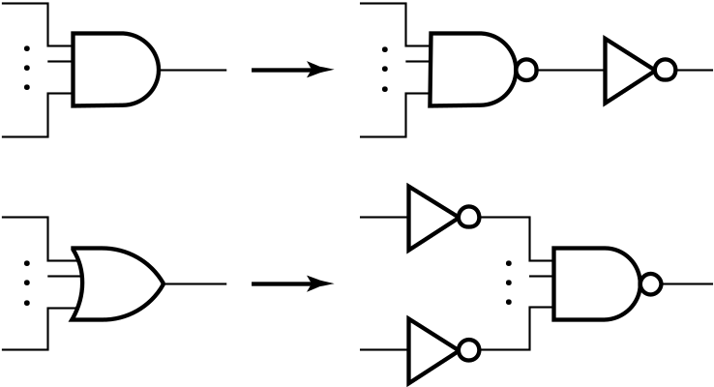
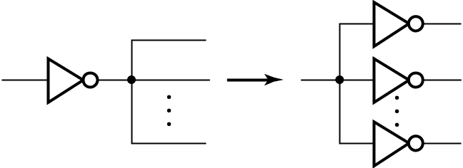

NAND Mapping Algorithm
Replace ANDs and ORs:
Repeat the following pair of actions until there is at most one inverter between :
  A circuit input or driving NAND gate output, and
  The attached NAND gate inputs.

Slide 20
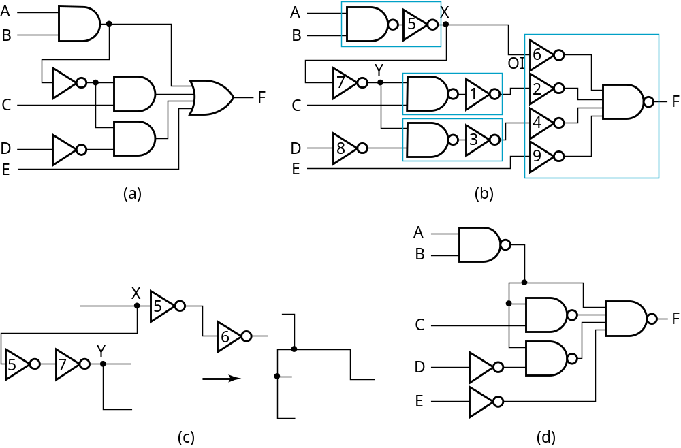
NAND Mapping Example

Slide 21
Mapping to NOR gates
Assumptions:
  Gate loading and delay are ignored
  Cell library contains an inverter and n-input NOR gates, n = 2, 3, …
  An AND, OR, inverter schematic for the circuit is available
The mapping is accomplished by:
  Replacing AND and OR symbols,
  Pushing inverters through circuit fan-out points, and
  Canceling inverter pairs

Slide 22
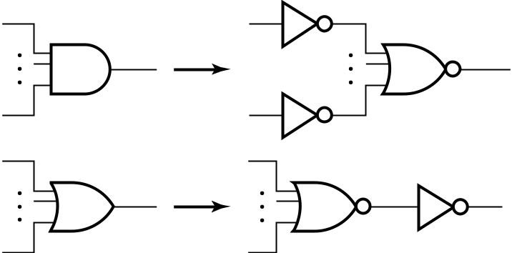
NOR Mapping Algorithm
Replace ANDs and ORs:
Repeat the following pair of actions until there is at most one inverter between :
  A circuit input or driving NAND gate output, and
  The attached NAND gate inputs.

Slide 23
NOR Mapping Example
A
A
B
B
2
1
X
C
F
C
3
F
D
D
E
E
(a)
A
(b)
B
C
F
D
E
(c)

Slide 24
Verification
Verification - show that the final circuit designed implements the original specification
Simple specifications are:
  truth tables
  Boolean equations
  HDL code

Slide 25
Basic Verification Methods
Manual Logic Analysis
  Find the truth table or Boolean equations for the final circuit
  Compare the final circuit truth table with the specified truth table, or
  Show that the Boolean equations for the final circuit are equal to the specified Boolean equations
Simulation
  Simulate the final circuit (or its netlist, possibly written as an HDL) and the specified truth table, equations, or HDL description using test input values that fully validate correctness.
  The obvious test for a combinational circuit is application of all possible “care” input combinations from the specification

Slide 26
Decoding
Decoding - the conversion of an n-bit input code to an m-bit output code with
n ≤ m ≤ 2^{n} such that each valid code word produces a unique output code
Circuits that perform decoding are called decoders
Here, functional blocks for decoding are
  called n-to-m line decoders, where m ≤ 2^{n}, and
  generate 2^{n} (or fewer) minterms for the n input variables

Slide 27
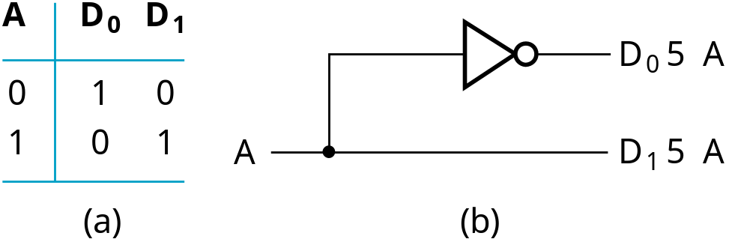
Decoder Examples
1-to-2-Line Decoder
2-to-4-Line Decoder
A
0
A
1
A
0
D
0
D
1
D
2
D
3
A
1
0
0
1
0
0
0
D
5
A
A
0
1
0
1
0
0
0
1
0
1
0
0
0
1
0
1
1
0
0
0
1
D
1
5
A
1
A
0
(a)
D
2
5
A
1
A
0
Note that the 2-4-line
made up of 2 1-to-2-
line decoders and 4 AND gates.
D
3
5
A
1
A
0
(b)

Slide 28
Decoder Expansion
General procedure for any decoder with n inputs and 2^{n} outputs.
This procedure builds a decoder backward from the outputs.
The output AND gates are driven by two decoders with their numbers of inputs either equal or differing by 1.
These decoders are then designed using the same procedure until 2-to-1-line decoders are reached.
The procedure can be modified to apply to decoders with the number of outputs ≠ 2^{n}

Slide 29
Decoder Expansion - Example 1
3-to-8-line decoder
  Number of output ANDs = 8
  Number of inputs to decoders driving output ANDs = 3
  Closest possible split:
    2-to-4-line decoder
    1-to-2-line decoder
  2-to-4-line decoder
    Number of output ANDs = 4
    Number of inputs to decoders driving output ANDs = 2
    Closest possible split:
      Two 1-to-2-line decoders
See next slide for result

Slide 30
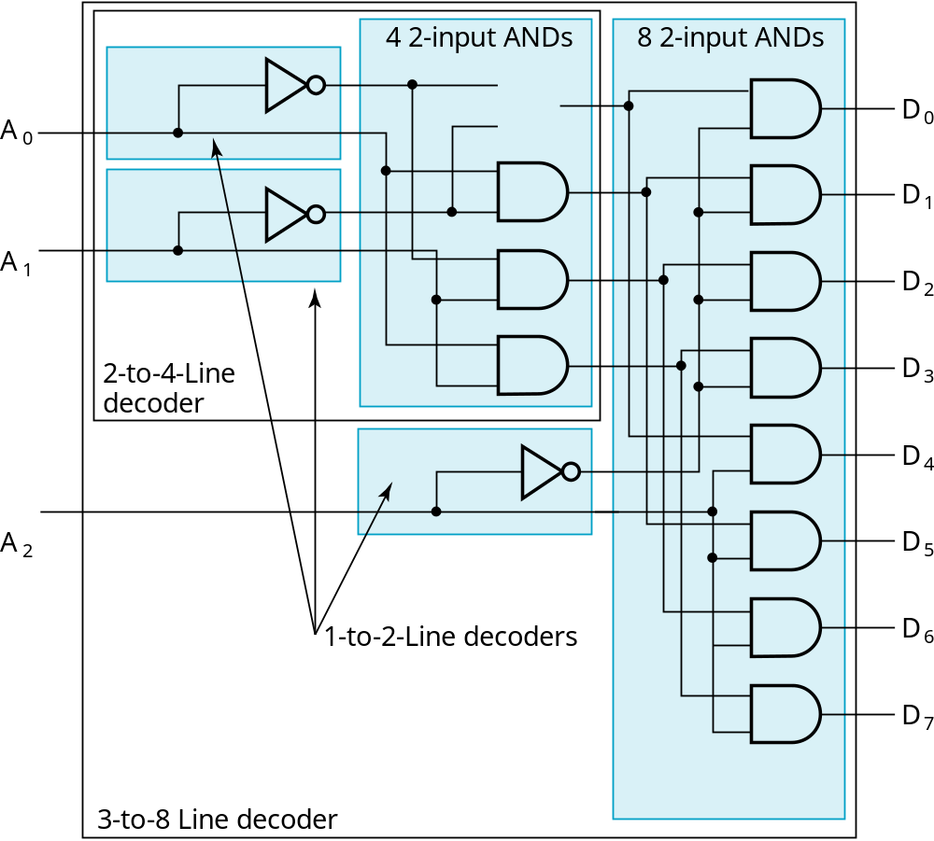
Decoder Expansion - Example 1
Result

Slide 31
Decoder Expansion - Example 2
7-to-128-line decoder
  Number of output ANDs = 128
  Number of inputs to decoders driving output ANDs = 7
  Closest possible split to match number of inputs
    4-to-16-line decoder
    3-to-8-line decoder
  4-to-16-line decoder
    Number of output ANDs = 16
    Closest possible split to match number of inputs
      Two 2-to-4-line decoders
  Complete using 3-8 and 2-to-4 line decoders already derived

Slide 32
Decoder as a Building Block
A decoder provides the 2^{n} minterms of n input variable
2x4
decoder
d0 = x’y’
x
d1 = x’y
d2 = xy’
y
d3 = xy
We can use a decoder and OR gates to realize any Boolean function expressed as sum of minterms
  Any circuit with n inputs and m outputs can be realized using an n-to-2^{n} decoder and m OR gates.

Slide 33
Example: Decoder as a Building Block
  C = xy + xz + yz = Σ(3, 5, 6, 7)
  S = x ⊕ y ⊕ z = Σ(1, 2, 4, 7)
0
3x8
decoder
x
1
2
C
3
y
4
5
S
6
z
7

Slide 34
Encoding
Encoding - the opposite of decoding - the conversion of an m-bit input code to a n-bit output code with n ≤ m ≤ 2^{n} such that each valid code word produces a unique output code
Circuits that perform encoding are called encoders
An encoder has 2^{n} (or fewer) input lines and n output lines which generate the binary code corresponding to the input values
Typically, an encoder converts a code containing exactly one bit that is 1 to a binary code corres-ponding to the position in which the 1 appears.

Slide 35
Encoder Example
A decimal-to-BCD encoder
  Inputs: 10 bits corresponding to decimal digits 0 through 9, (D₀, …, D₉)
  Outputs: 4 bits with BCD codes
  Function: If input bit D_{i} is a 1, then the output (A₃, A₂, A₁, A₀) is the BCD code for i,
The truth table could be formed, but alternatively, the equations for each of the four outputs can be obtained directly.

Slide 36
Encoder Example (continued)
Input D_{i} is a term in equation A_{j} if bit A_{j} is 1 in the binary value for i.
Equations:
  A₃ = D₈ + D₉
  A₂ = D₄ + D₅ + D₆ + D₇
  A₁ = D₂ + D₃ + D₆ + D₇
  A₀ = D₁ + D₃ + D₅ + D₇ + D₉
F₁ = D₆ + D₇ can be extracted from A₂ and A₁ Is there any cost saving?
Notes:
No. The total gate input cost remains the same.

Slide 37
Priority Encoder
If more than one input value is 1, then the encoder just designed does not work.
One encoder that can accept all possible combinations of input values and produce a meaningful result is a priority encoder.
Among the 1s that appear, it selects the most significant input position (or the least significant input position) containing a 1 and responds with the corresponding binary code for that position.

Slide 38
Priority Encoder Example
Priority encoder with 4 inputs (D₄, D₃, D₂, D₁) – most significant bit has highest priority - Code outputs A1, A0 and V where V indicates at least one 1 present.
Xs in input part of table represent 0 or 1; thus table entries correspond to product terms instead of minterms. The column on the left shows that all combined minterms are present in the product terms in the table
No. of Min-terms/Row
 | D3 | D2 | D1 | D0 | A1 | A0 | V
1 | 0 | 0 | 0 | 0 | X | X | 0
1 | 0 | 0 | 0 | 1 | 0 | 0 | 1
2 | 0 | 0 | 1 | X | 0 | 1 | 1
4 | 0 | 1 | X | X | 1 | 0 | 1
8 | 1 | X | X | X | 1 | 1 | 1
Notes:
Go over table explaining how entries were obtained, particularly those containing Xs

Slide 39
Priority Encoder Example (continued)
Could use a K-map to get equations, but can be read directly from table and manually optimized if careful:
  A₁ = D₃ + D₂
  A₀ = D₃ + D₁ D₂
  V = D₀ + D₁ + D₂ + D₃

Slide 40
Selecting
Selecting of data or information is a critical function in digital systems and computers
Circuits that perform selecting have:
  A set of information inputs from which the selection is made
  A single output
  A set of control lines for making the selection
Logic circuits that perform selecting are called multiplexers
Selecting can also be done by three-state logic

Slide 41
Multiplexers
A multiplexer selects information from an input line and directs the information to an output line
A typical multiplexer has n control inputs (S_{n − 1}, … S₀) called selection inputs, 2^{n} information inputs (I₂^{n} ₋ ₁, … I₀), and one output Y
A multiplexer can be designed to have m information inputs with m < 2^{n} as well as n selection inputs

Slide 42
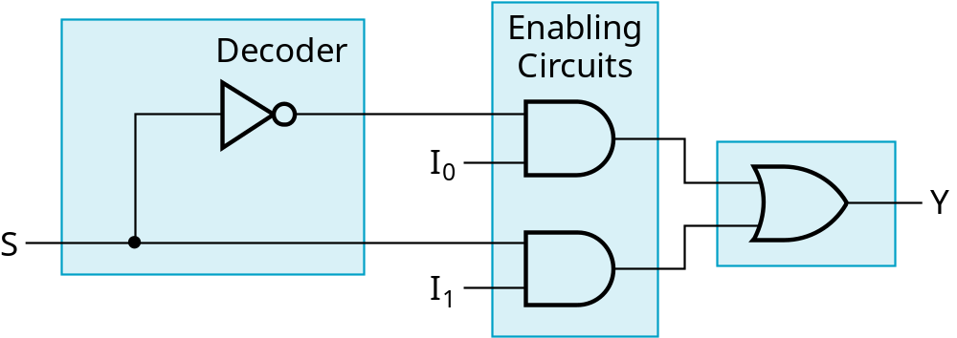
2-to-1-Line Multiplexer
Since 2 = 2¹, n = 1
The single selection variable S has two values:
  S = 0 selects input I₀
  S = 1 selects input I₁
The equation:
Y = I₀ + SI₁
The circuit:
S

Slide 43
2-to-1-Line Multiplexer (continued)
Note the regions of the multiplexer circuit shown:
  1-to-2-line Decoder
  2 Enabling circuits
  2-input OR gate
To obtain a basis for multiplexer expansion, we combine the Enabling circuits and OR gate into a 2 × 2 AND-OR circuit:
  1-to-2-line decoder
  2 × 2 AND-OR
In general, for an 2^{n}-to-1-line multiplexer:
  n-to-2^{n}-line decoder
  2^{n} × 2 AND-OR

Slide 44
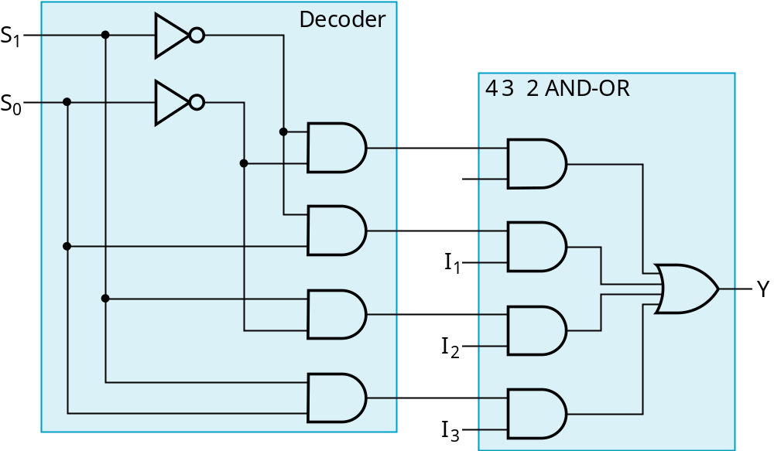
Example: 4-to-1-line Multiplexer
2-to-2²-line decoder
2² × 2 AND-OR

Slide 45
4-to-1-Line Multiplexer with 3 input ANDs
I0
I1
Y
I2
I3
S1
S0

Slide 46
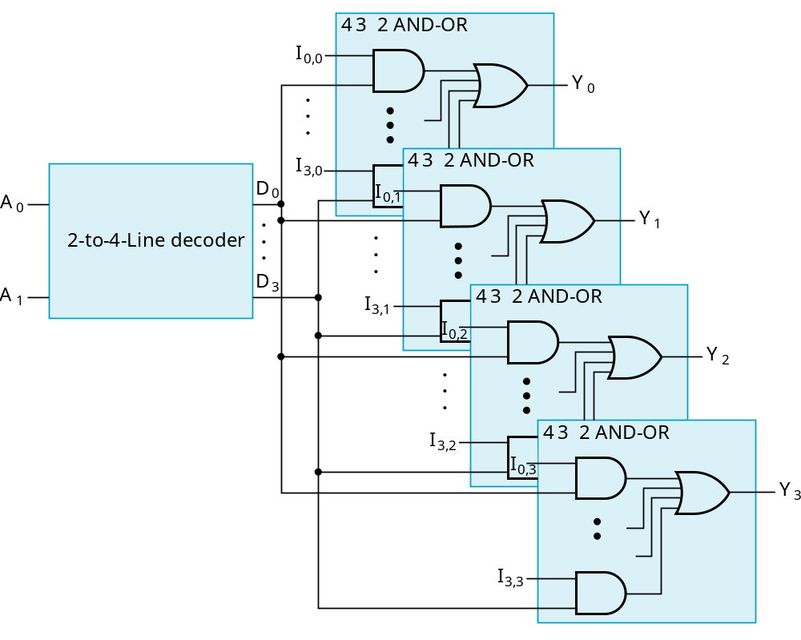
Multiplexer Width Expansion
Select “vectors of bits” instead of “bits”
Use multiple copies of 2^{n} × 2 AND-OR in parallel
Example:
4-to-1-line
quad multi-
plexer

Slide 47
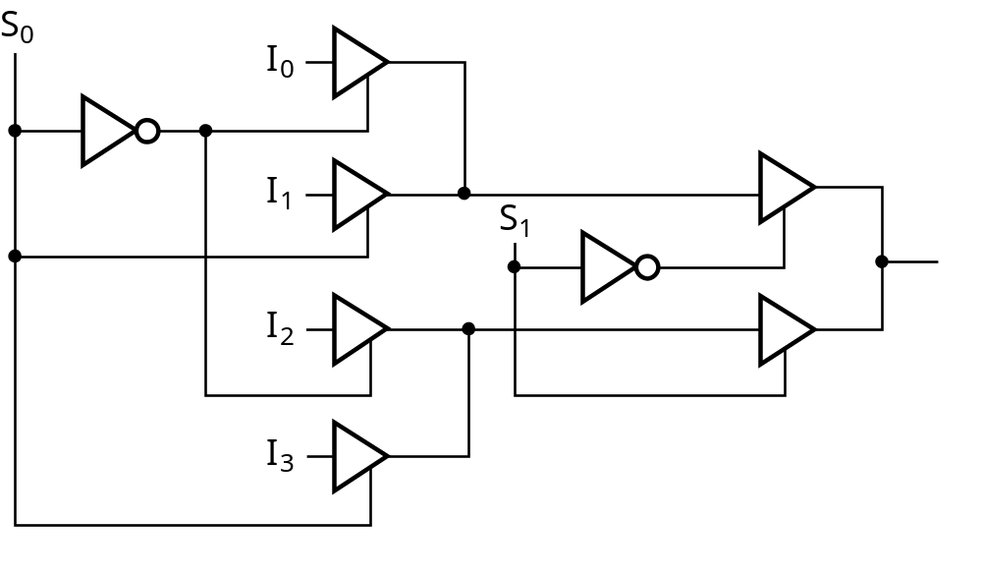
Other Selection Implementations
Three-state logic in place of AND-OR
Gate input cost = 14 compared to 22

Slide 48
Combinational Logic Implementation
- Multiplexer Approach 1
Implement m functions of n variables with:
  Sum-of-minterms expressions
  An m-wide 2^{n}-to-1-line multiplexer
Design:
  Find the truth table for the functions.
  In the order they appear in the truth table:
    Apply the function input variables to the multiplexer inputs S_{n − 1}, … , S₀
    Label the outputs of the multiplexer with the output variables
  Value-fix the information inputs to the multiplexer using the values from the truth table (for don’t cares, apply either 0 or 1)

Slide 49
Example: Gray to Binary Code
Design a circuit to
convert a 3-bit Gray
code to a binary code
The formulation gives
the truth table on the
right
It is obvious from this
table that X = C and the
Y and Z are more complex
Gray
Binary
A B C
x y z
0
0
0
0
0
0
1 0
0
0
0 1
1
1 0
0 1 0
0 1 0
0 1
1
0 1
1
1 0
0
1
1
1
1 0 1
1 0 1
1
1 0
0
0 1
1
1
1

Slide 50
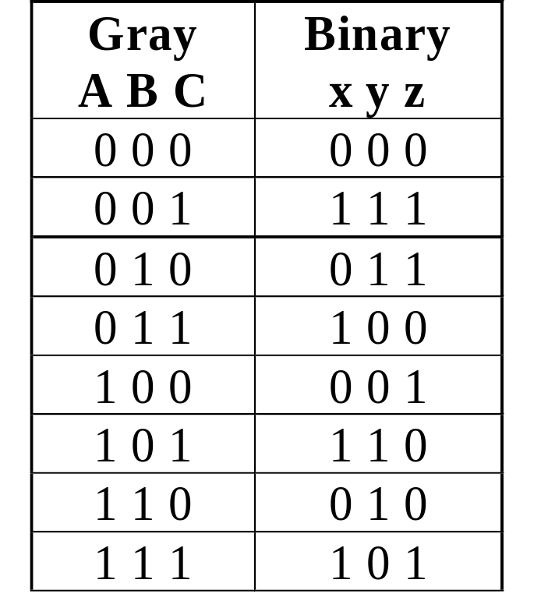
Gray to Binary (continued)
Rearrange the table so
that the input combinations
are in counting order
Functions y and z can
be implemented using
a dual 8-to-1-line
multiplexer by:
  connecting A, B, and C to the multiplexer select inputs
  placing y and z on the two multiplexer outputs
  connecting their respective truth table values to the inputs

Slide 51
Gray to Binary (continued)
0
D00
0
D10
1
D01
1
D11
1
D02
1
D12
0
D03
0
D13
0
D04
1
D14
1
Out
Y
0
Out
Z
D05
D15
1
D06
0
D16
0
D07
1
D17
A
S2
A
S2
8-to-1
8-to-1
B
S1
B
S1
MUX
S0
MUX
C
S0
C

Slide 52
Efficient Design with Multiplexers – Approach 2
More efficient way to implement an n-variable Boolean function
  Use a multiplexer with n-1 selection inputs
  First (n-1) variables are connected to the selection inputs
  The remaining variable is connected to data inputs

Slide 53
Example: Efficient Design with Multiplexers
F(x, y, z) = Σ(1, 2, 6, 7)
  F = x′y′z + x′yz′ + xyz′ + xyz
x
y
z
F
0
0
0
0
F =
0
0
1
1
0
1
0
1
F =
0
1
1
0
1
0
0
0
F =
1
0
1
0
1
1
0
1
F =
1
1
1
1
  I₀ = z, I₁ = z′, I₂ = 0, I₃ = 1.

Slide 54
Example: Efficient Design with Multiplexers
F = x′y′z + x′yz′ + xyz′ + xyz
F = z when x = 0 and y = 0
F = z′ when x = 0 and y = 1
F = 0 when x = 1 and y = 0
F = 1 when x = 1 and y = 1
0
1
MUX
F = x′y′z + x′yz′ + xy
2
3
x y

Slide 55
Efficient Design with Multiplexers
General procedure for n-variable Boolean function
  F(x₁, x₂, ..., x_{n})
The Boolean function is expressed in a truth table
The first (n-1) variables are applied to the selection inputs of the multiplexer (x₁, x₂, ..., x_{n-1})
For each combination of these (n-1) variables, evaluate the value of the output as a function of the last variable, x_{n}.
  0, 1, x_{n}, x_{n}′
These values are applied to the data inputs in the proper order.

Slide 56
Demultiplexer
A demultiplexer is a combinational circuit
  it receives information from a single line and directs it one of 2^{n} output lines
  It has n selection lines as to which output will get the input
d0
2x4
decoder
d0
d1
x
e
d1
d2
d2
d3
y
d3
x, y
d0 = e when x = 0 and y = 0
d1 = e when x = 0 and y = 1
d2 = e when x = 1 and y = 0
d3 = e when x = 1 and y = 1
e

Slide 57
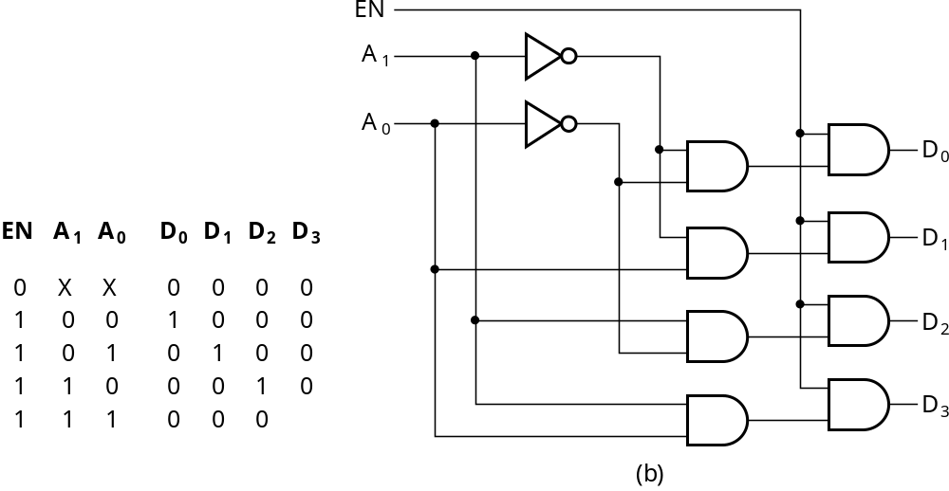
Decoder with Enable (Demultiplexer)
In general, attach m-enabling circuits to the outputs
See truth table below for function
  Note use of X’s to denote both 0 and 1
  Two X’s represent four binary combinations of A₀ and A₁
Alternatively, can be viewed as distributing value of signal EN to 1 of 4 outputs
In this case, called a
demultiplexer

Slide 58
Programmable Logic Devices (PLD’s)
Programmable Logic Devices are formed by AND and OR arrays. The gate arrays are programmed by using switches in order implement a special Boolean function.
We will discuss three PLDs in this course.
  Programmable Read Only Memory (PROM)
  Programmable Logic Array (PLA)
  Programmable Array Logic (PAL)

Slide 59
Programmable Logic Devices
Fixed
AND
Array
Programmable
OR
Array
PROM
Inputs
Outputs
Programmable
AND
Array
Fixed
OR
Array
PAL
Inputs
Outputs
Programmable
AND
Array
Programmable
OR
Array
PLA
Inputs
Outputs

Slide 60
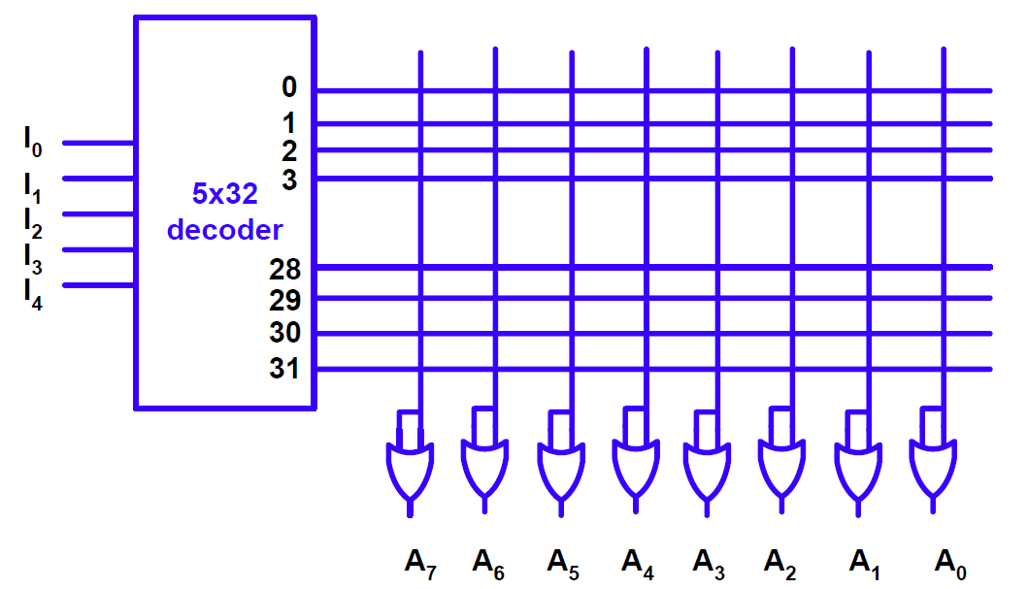
Read Only Memory (ROM)
ROM is a device which can store binary information and keep it even when the power is cut.
ROM contains a decoder and a fixed OR array.
Architecture of a 32x8-bit ROM

Slide 61
Combinational Circuit Design by Using ROM
It is direct implementation of a Boolean function.
  There is no need to optimize the Boolean function. It produces all the minterms.
Reprogramming gives the chance to implement different Boolean funcions on the same device.

Slide 62
Design with ROM
The truth table of the Boolean function shows the positions of the switches that are closed.
Inputs |  |  |  |  | Outputs
I₄ | I₃ | I₂ | I₁ | I₀ | A₇ | A₆ | A₅ | A₄ | A₃ | A₂ | A₁ | A₀
0 | 0 | 0 | 0 | 0 | 1 | 0 | 1 | 1 | 0 | 1 | 1 | 0
0 | 0 | 0 | 0 | 1 | 0 | 0 | 0 | 1 | 1 | 1 | 0 | 1
0 | 0 | 0 | 1 | 0 | 1 | 1 | 0 | 0 | 0 | 1 | 0 | 1
0 | 0 | 0 | 1 | 1 | 1 | 0 | 1 | 1 | 0 | 0 | 1 | 0
… |  |  |  |  | …
1 | 1 | 1 | 0 | 0 | 0 | 0 | 0 | 0 | 1 | 0 | 0 | 1
1 | 1 | 1 | 0 | 1 | 1 | 1 | 1 | 0 | 0 | 0 | 1 | 0
1 | 1 | 1 | 1 | 0 | 0 | 1 | 0 | 0 | 1 | 0 | 1 | 0
1 | 1 | 1 | 1 | 1 | 0 | 0 | 1 | 1 | 0 | 0 | 1 | 1

Slide 63
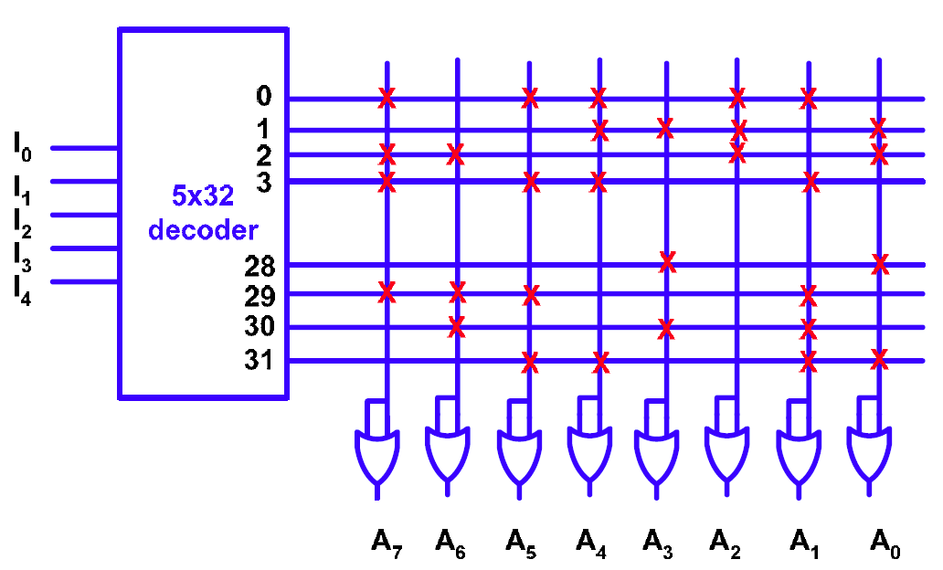
Design with ROM
X shows that there is connection. Hence X shows logic-1.
If there is no X, then there is no connection. Hence absense of X means logic-0.

Slide 64
Example
Design a circuit which calculates the square of the 3-bit input with ROM.
We have to find the input and output bit length.
  The input bit length is 3. The output bit length is 6. (7² = 49 = 110001₂)
We have to produce the truth table.
  Truth table:
x₂ | x₁ | x₀ | y₅ | y₄ | y₃ | y₂ | y₁ | y₀
0 | 0 | 0 | 0 | 0 | 0 | 0 | 0 | 0
0 | 0 | 1 | 0 | 0 | 0 | 0 | 0 | 1
0 | 1 | 0 | 0 | 0 | 0 | 1 | 0 | 0
0 | 1 | 1 | 0 | 0 | 1 | 0 | 0 | 1
1 | 0 | 0 | 0 | 1 | 0 | 0 | 0 | 0
1 | 0 | 1 | 0 | 1 | 1 | 0 | 0 | 1
1 | 1 | 0 | 1 | 0 | 0 | 1 | 0 | 0
1 | 1 | 1 | 1 | 1 | 0 | 0 | 0 | 1

Slide 65
Example
We decide that y₀ = x₀ and y₁ = 0 from the truth table.
We need a 8×4 ROM.
0 | 0 | 0 | 0
0 | 0 | 0 | 0
0 | 0 | 0 | 1
0 | 0 | 1 | 0
0 | 1 | 0 | 0
0 | 1 | 1 | 0
1 | 0 | 0 | 1
1 | 1 | 0 | 0
x0
3x8
Decoder
x1
x2
y5
y4
y3
y2

Slide 66
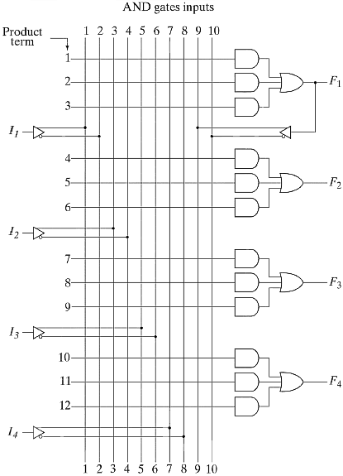
Programmable Array Logic (PAL)

Slide 67
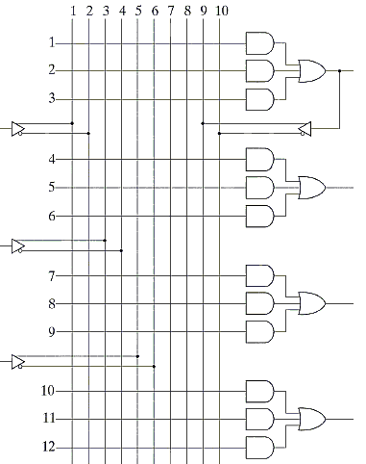
Design with PAL
y5 = x2x1
01
00
11
10
y5
x2x1
x0
x2
0
1
y4
1
1
1
x1
y4 = x2x1′ + x2x0
y3
y3 = x2′x1x0 + x2x1′x0
x0
y2 = x1x0′
y2

Slide 68
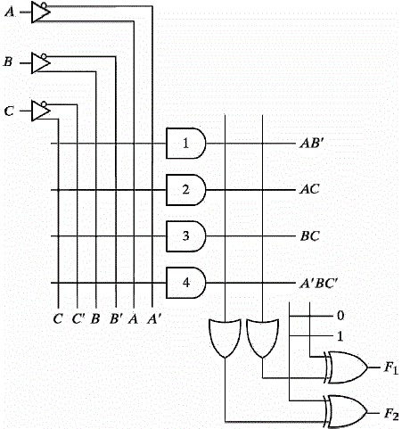
Programmable Logic Array (PLA)
F1 = AB' + AC + A'BC'
F2 = (AC + BC)'

